Slide 1
Overview of Query Evaluation
A user query is expressed using SQL or other languages, ideally natural languages
A parsed query is essentially treated as a relational algebra expression with a set of basic operators whose operands are tables/relations
  Selection (б)
  Join (⋈)
  Project(Π)
  Union, intersection and difference, cross product, division
Query optimizer
  Enumerates the possible plans to evaluate expression,
  Select a small subset of these plans and estimate their cost
User Query
Query Parser
Parsed Query
Query Optimizer
Plan
Generator
Plan Cost
Estimator
Catalog
Manager
Query Plan Evaluator

Slide 2
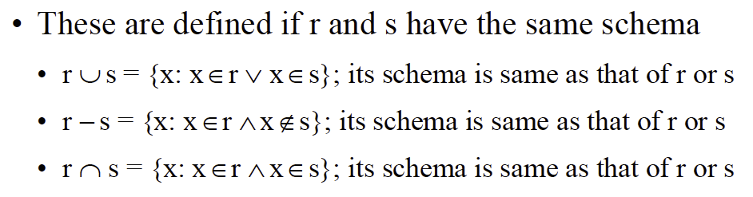
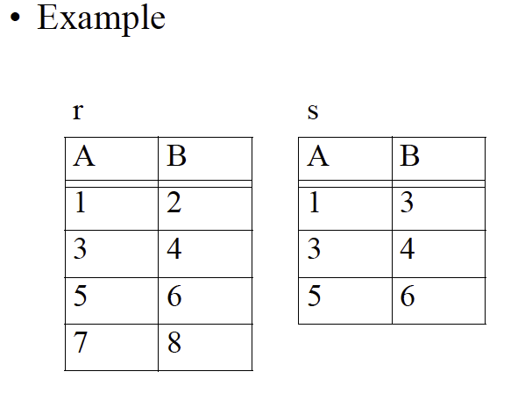
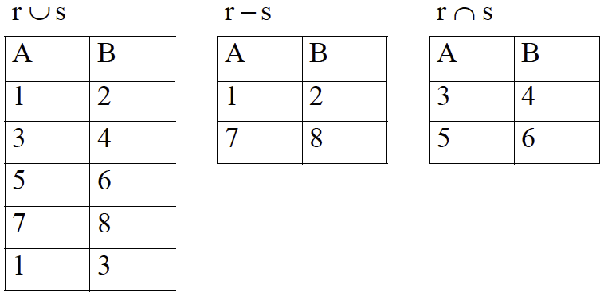
Union, Intersection and Difference Operators
(R-S) U (R ^S) → R

Slide 3
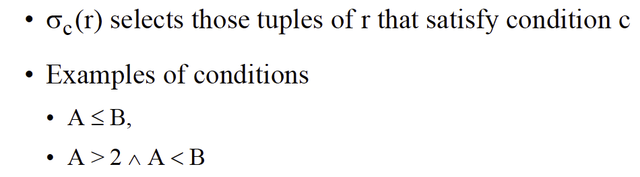

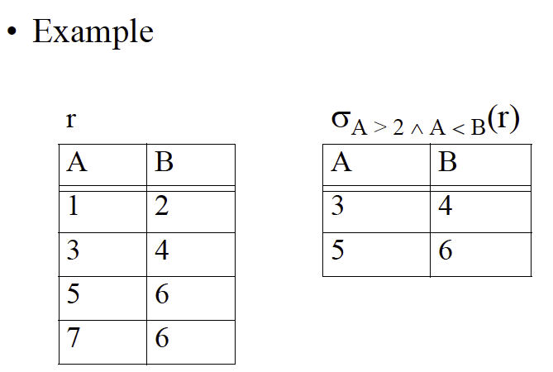
Select Operator
SELECT R_{A<B}
(3, 4)
(5, 6)

Slide 4
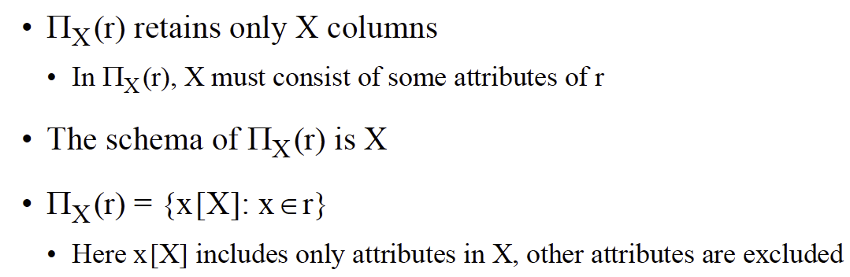
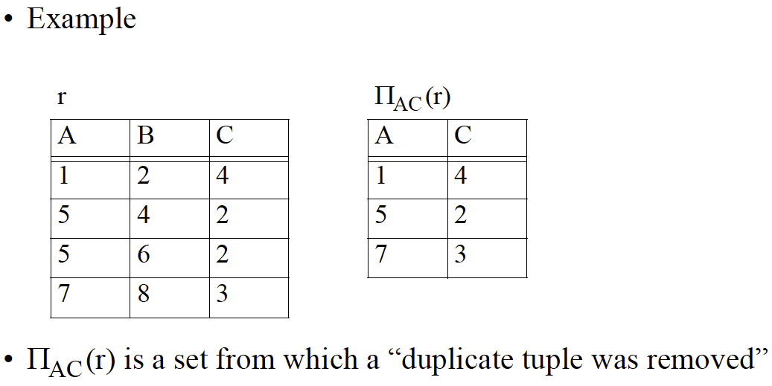
Project Operator

Slide 5
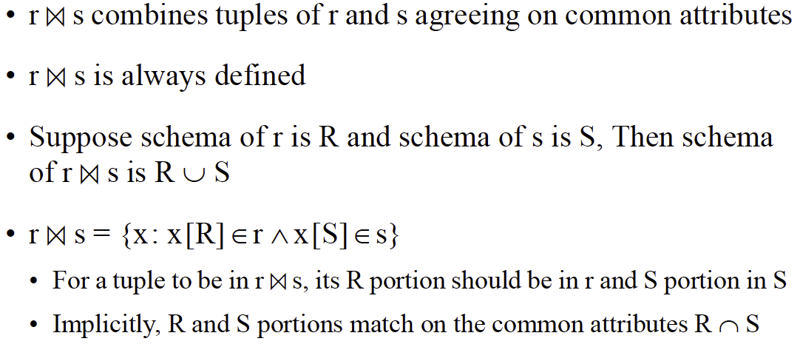

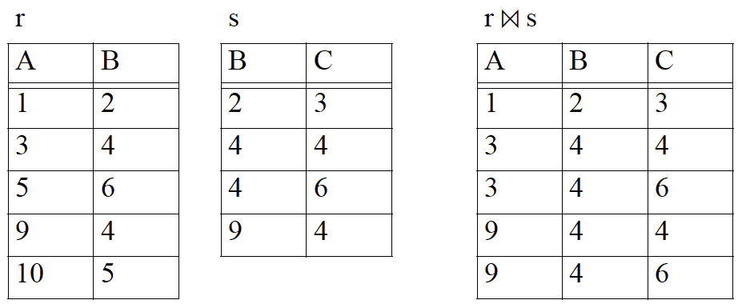
Natural Join Operator

Slide 6
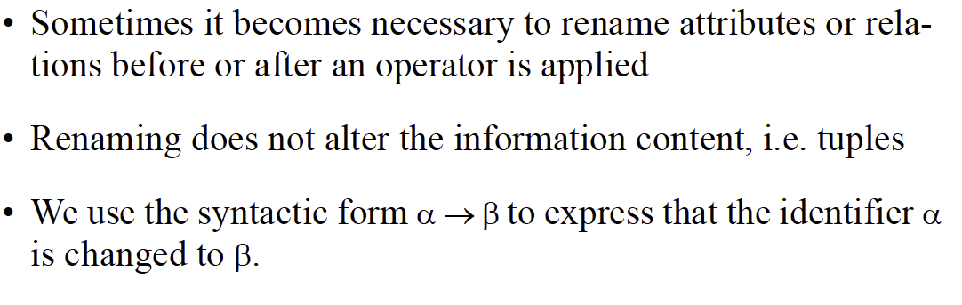
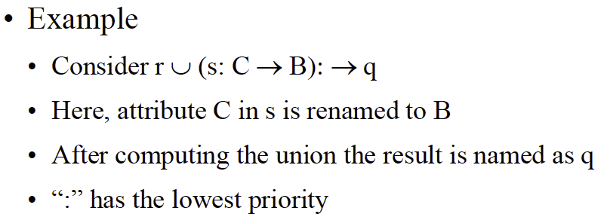
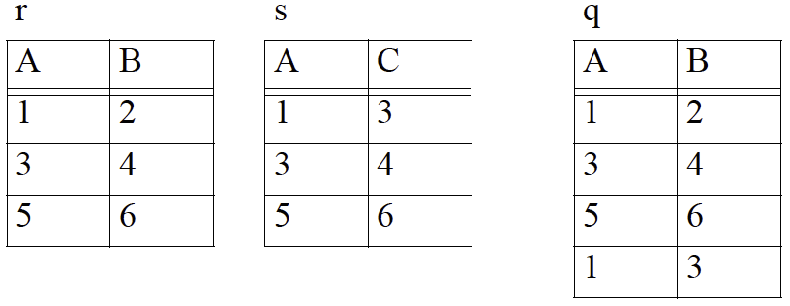
Renaming Operator
R U S → q
Q - S

Slide 7
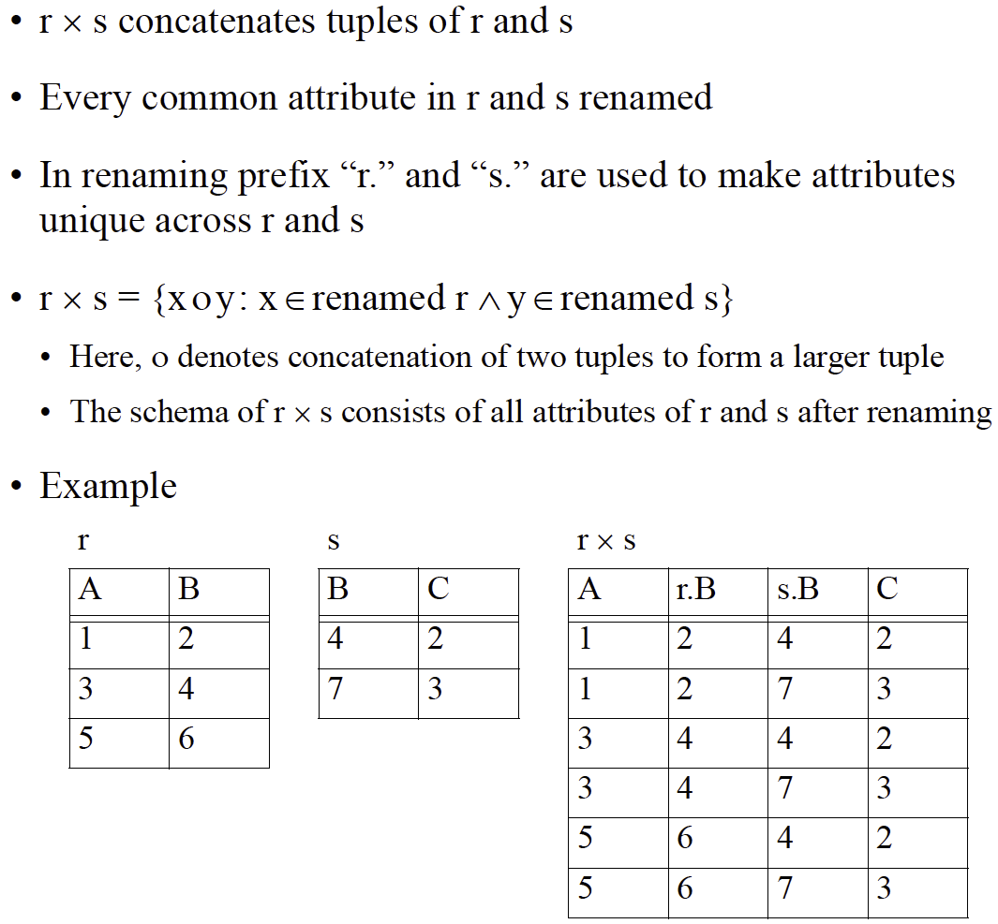
Cross Product Operator

Slide 8
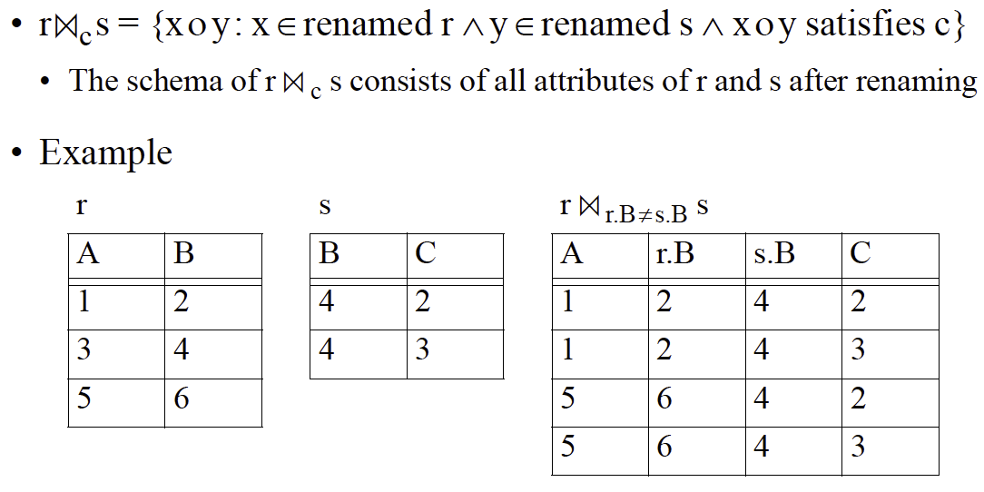
Additional Join Operators
R crossproduct_{r.B < s.B). S
1 2. 4. 2
1 2. 4. 3

Slide 9
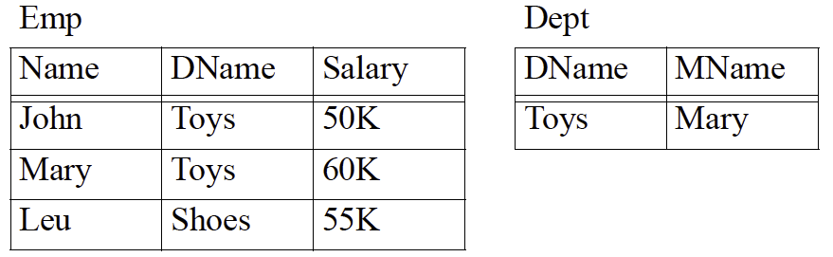
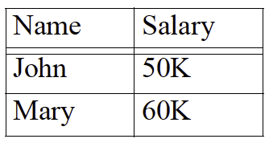
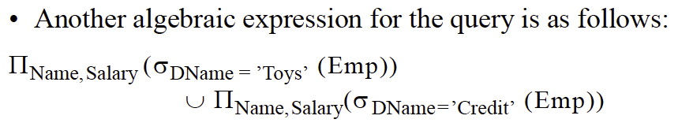
Relational Algebra as a Query Language

Slide 10
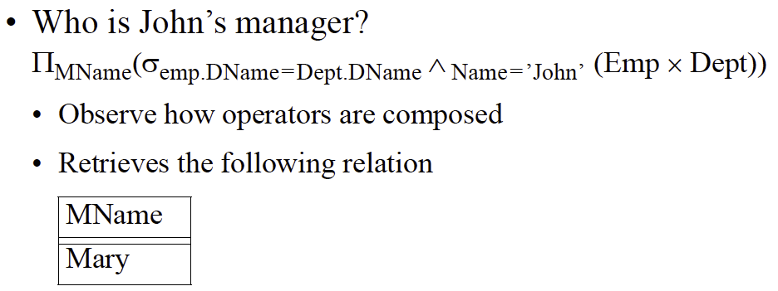
Relational Algebra as a Query Language

Slide 11
Exercise
Π
б
⋈
Sailors(sid, sname, rating, age)
Boats(bid, bname, color)
Reserve(sid, bid, day)
Find the names of sailors who have reserved boat 103
Π_{sname} (Π_{sid}(Б_{bid=103} (Reserve)) ⋈_{S.sid == Sailors.sid} Sailors)

Slide 12
Exercise
Sailors(sid, sname, rating, age)
Boats(bid, bname, color)
Reserve(sid, bid, day)
Find the names of sailors who have reserved boat 103
Π_{sname}(б_{bid=103}(Reserves ⋈ Sailors))

Slide 13
Exercise
Sailors(sid, sname, rating, age)
Boats(bid, bname, color)
Reserve(sid, bid, day)
Find the names of sailors who have reserved a red boat
Project _{sname} (Select_{color = “red”} (Boats & Reserve & Sailors))
Notes:
This exercise comes from Chapter 4

Slide 14
Exercise
Sailors(sid, sname, rating, age)
Boats(bid, bname, color)
Reserve(sid, bid, day)
Find the names of sailors who have reserved a red boat
Π_{sname}(б_{color=“red”} (Boats ⋈ Reserves ⋈ Sailors))
expressions can be different, but all produce the correct result
Notes:
This exercise comes from Chapter 4

Slide 15
Exercise
Sailors(sid, sname, rating, age)
Boats(bid, bname, color)
Reserve(sid, bid, day)
Find the colors of boats reserved by Lubber
Π_{color} (б_{sname=“Lubber”} (Reserves ⋈ Sailors ⋈ Boats))

Slide 16
Exercise
Sailors(sid, sname, rating, age)
Boats(bid, bname, color)
Reserve(sid, bid, day)
Find the colors of boats reserved by Lubber
Π_{color}(Boats) -
Π_{color} (б_{sname=“Lubber”} (Reserves ⋈ Sailors ⋈ Boats))

Slide 17
Sailors(sid, sname, rating, age)
Boats(bid, bname, color)
Reserve(sid, bid, day)
Find the names of sailors who have reserved a red or a green boat

Slide 18
Sailors(sid, sname, rating, age)
Boats(bid, bname, color)
Reserve(sid, bid, day)
Find the names of sailors who have reserved a red or a green boat

Slide 19

Sailors(sid, sname, rating, age)
Boats(bid, bname, color)
Reserve(sid, bid, day)
Find the names of sailors who have reserved at least one boat
$⊓sname$(Reserve $⋈$ Sailors)

Slide 20
Sailors(sid, sname, rating, age)
Boats(bid, bname, color)
Reserve(sid, bid, day)
Find the sids of sailors with age over 20 who have not reserved a red boat
you work yourself!

Slide 21
Reading Materials
Relational Algebra on Wikipedia

